Slide 1
FUNCTIONS
FUNCTIONS
In
Oracle 11g

Slide 2
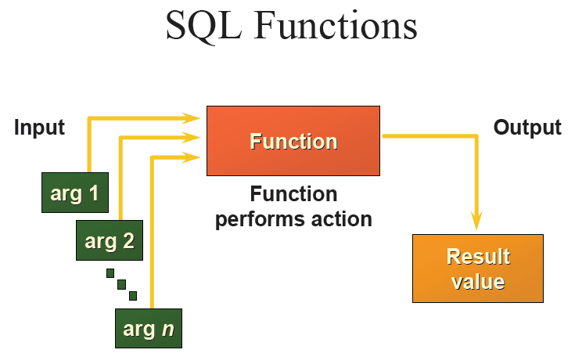
FUNCTIONS

Slide 3
FUNCTIONS
Classified Into 5 Significant Classes
1. Single Row Functions
2. Aggregate Functions/ Group Functions
3. Analytical Functions
4. Object Reference Functions
5. User Defined Functions

Slide 4
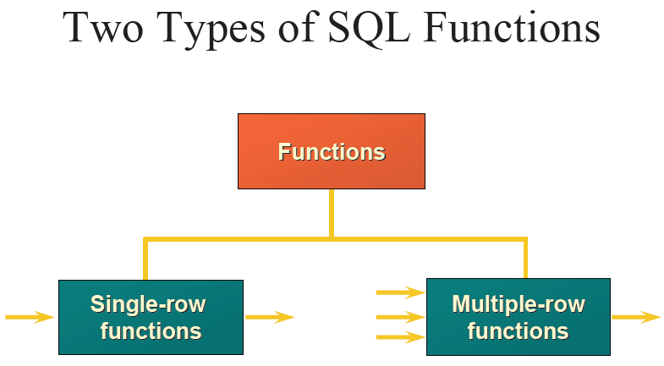
FUNCTIONS

Slide 5
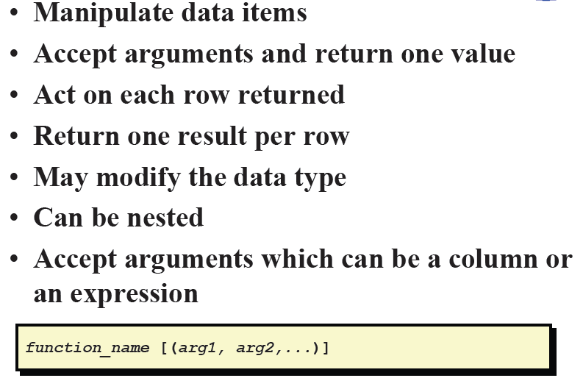
SINGLE ROW FUNCTIONS

Slide 6
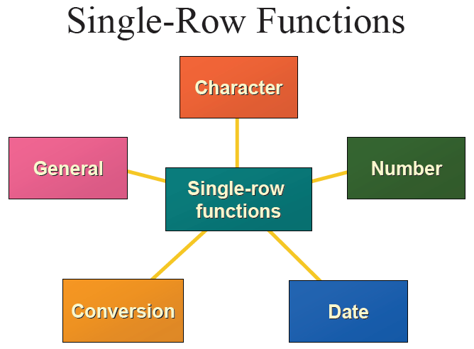
SINGLE ROW FUNCTIONS

Slide 7
SPECIAL FUNCTIONS
Special NULL Functions
Most of the functions Work in the model of NULL IN NULL OUT.
Only few Functions like CONCAT, DECODE, NVL, NVL2, REPLACE, DUMP can return a non-Null value even having a NULL argument.
To deal with the problem of NULL value we use two Functions NVL and NVL2
NVL(<X1>,<X2>)
NVL2(<X1>,<X2>,<X3>)

Slide 8
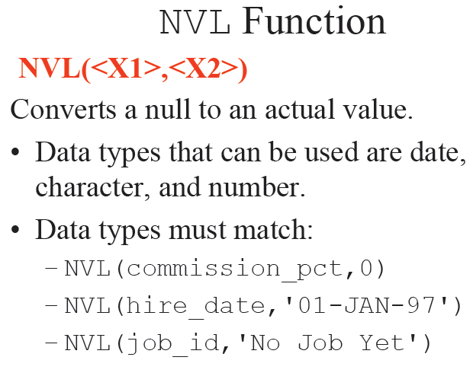

Slide 9
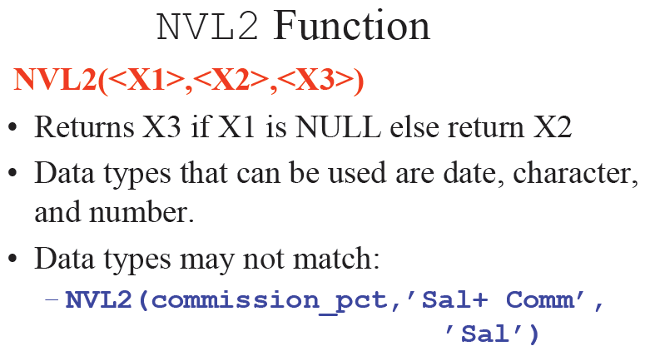

Slide 10
ASCII(<C1>)
Arguments: C1- Character String
Returns: Decimal Value
Description: It calculates the ASCII equivalent of the first character of the given input string.
Example: SELECT ASCII(‘A’) Big_A, ASCII(‘NIST’) NIST FROM dual
Result: Big_A NIST
-------------- ----------------
65 78

Slide 11
CHR(<i>[USING NCHAR_CS])
Arguments: i – An integer
USING NCHAR_CS – Is an optional parameter
Returns: A character
Description: Returns the character equivalent of the given integer.
The default behavior is to return the character from the Database Character Set.
If the optional parameter USING NCHAR_CS is used then it will return a character from National Character Set.

Slide 12
Example:
SELECT CHR(65), CHR(123) FROM dual;
Result: CHR (65) CHR(123)
------------- --------------
A {

Slide 13
CONCAT(<C1>,<C2>)
Arguments: C1 and C2 are both character strings
Returns: A string
Description: This function returns C2 appended to C1. IF C2 is Null it returns C1, If C1 is Null it returns C2, If both are null it returns Null.
Example: SELECT CONCAT('Oracle ', 'Certification') username FROM Dual;
Result: USERNAME
--------------------------
Oracle Certification

Slide 14
INITCAP(<C1>)
Argument: A character string C1
Returns: A character string
Description: This function returns C1 with the first character of each word in upper case and all other in lower case.
Example: SELECT INITCAP('We are nistians') FROM Dual;
Result: INITCAP('WEAREN
    -----------------------------
We Are Nistians

Slide 15
LENGTH(<C1>)
Argument: A character String C1
Returns: A numeric Value
Description: It returns the length of the character string. If the string is a NULL string than it returns a NULL.
Example: SELECT LENGTH('i am an indian') my_length FROM Dual;
Result: MY_LENGTH
    --------------------
14
LENGTHB(<C1>)
Is same as Length but it calculates the length in bytes.

Slide 16
INSTR(<C1>,<C2>[,<i>[,<j>]])
Arguments: C1, C2 are two character strings
i, j are two integers
Returns: Integer indicating position
Description:
    This function returns the numeric character position in C1 where jth occurrence of C2 is found
    Search begins from the ith character position in C1 INSTR returns 0 when the required string is not found.
    If i is negative, the search is performed back ward but the position is still counted from left.
    Default value of i and j are 1

Slide 17
Example:
SELECT INSTR('Mississippi','i',1,1) POS1
, INSTR('Mississippi','i',1,4) POS2
, INSTR('Mississippi','i',-1,3) POS3
FROM Dual;
Result: POS1 POS2 POS3
    --------- -------- -------
      2 11 5
INSTRB(<C1>,<C2>[,<i>[,<j>]])
Same as INSTR But it returns Byte position instate of character position.
For single byte character set INSTR is equivalent to INSTRB

Slide 18
LOWER(<C>)
Arguments: A Character String C
Returns: A Character String
Description: This function returns a character string with all characters in lower case.
Example: SELECT LOWER(' I caN rEAd The Text') “Lower_Case” FROM Dual
Result: Lower_Case
-------------------------------
i can read the text

Slide 19
  UPPER(<C>)
  Arguments: Takes a single character string C
  Returns: A character String
  Description: This function returns the string C with all characters in upper case
Example: SELECT UPPER('kiNg')FROM Dual;
Result: UPPE
--------
KING

Slide 20
LPAD(<C1>,<i>[,<C2>])
Arguments: C1, C2 are character string and i is an integer
Returns: A string
Description: This function returns the character string C1 expanded in length to i characters, using C2 to fill in space as needed on the left side of C1.
    If C1 is more than i characters, it is truncated to i characters
    C2 defaults to a single space

Slide 21
Example:
        SELECT LPAD('Nistian',10,'.') dot_Padded,
    LPAD('Nistian’,7, ' ') Space_padded,
    LPAD('Nistian',5,'.') Trunc_padded FROM Dual;
Result: DOT_PADDED SPACE_PADDED TRUNC_PADDED
    ----------------------- ------------------------- ------------------------
    ...Nistian Nistian Nisti
RPAD(<C1>,<i>[,<C2>])
RPAD is same as LPAD but C2 is padded at the right side.

Slide 22
LTRIM(<C1>[,<C2>])
Arguments: C1 and C2 are two character strings
Returns: A string
Description:
    This function returns C1 without any leading character that appears in C2.
    If no C2 characters are leading character in C1, then C1 is returned unchanged.
    C2 defaults to a single space.

Slide 23
Examples: Select LTRIM('Mississippi','Mis') trim1
, LTRIM('Rpadded ') trim2
, LTRIM(' Lpadded') trim3
, LTRIM(' Lpadded','z') trim4
Result: TRIM1 TRIM2 TRIM3 TRIM4
---------- ---------------- ----------- --------------------
ppi Rpadded Lpadded Lpadded
RTRIM(<C1>[,<C2>])
    Same as LTRIM but the characters are trimmed from the right side.

Slide 24
TRIM([[<C1>] <C2> FROM]<C3>)
Arguments: C1, C2, C3 are three character strings
Description:
  If present C1 can be one of the following literal: LEADING, TRAILING, BOTH.
  This function returns C3 with all C1(leading trailing or both) occurrences of characters in C2 removed.
  If any of C1,C2 or C3 is Null, This function returns a Null.
  C1 defaults to BOTH, and C2 defaults to a space character.

Slide 25
Example 1:
SELECT TRIM(BOTH ‘x’ from ‘xxTRIM MExxx’) both_trim, TRIM(LEADING ‘x’ from ‘xxTRIM MExxx’) trim FROM Dual
Results: BOTH_TR TRIM
    --------- --------
TRIM ME TRIM MExxx
Example 2:
SELECT TRIM(' Hello ') both_trim,
    TRIM('Hello ') trim FROM Dual
Results: BOTH_ TRIM
    --------- --------
Hello Hello

Slide 26
REPLACE(<C1>,<C2>[,<C3>])
Arguments: C1, C2, C3 are two character strings
Returns: A character string
Description:
This function returns C1 with all occurrence of C2 replaced with C3.
C3 defaults to null, if it is null then all occurrences of C2 is removed.
If C2 is Null C1 returned unchanged.
If C1 is Null then a null is returned

Slide 27
Example: SELECT REPLACE (‘HERO’, ’HE’, ’ZE’) ex_replace
FROM Dual
Result: EX_R
--------
ZERO

Slide 28
SUBSTR(<C1>,<x>[,<y>])
Arguments: C1 is a character string
x, y are two integers
Returns: A character string
Description:
This function returns the portion of C1 that is y characters long, beginning from position x.
    If x is negative, the position is counted backward
    If y is zero or negative this function returns a NULL.

Slide 29
Example:
SELECT SUBSTR('I Proud to be an Indian',1,3)INDIAN
    ,SUBSTR('I Proud to be an Indian',5,5)INDIAN1
    ,SUBSTR('I Proud to be an Indian',11)INDIAN2
    ,SUBSTR('I Proud to be an Indian',-10)INDIAN3
    FROM Dual;
Result: IND INDIA INDIAN2 INDIAN3
    ------ --------- --------------- --------------
  I P oud t be an Indian an Indian
SUBSTRB(<C1>,<i>[,<j>])
This function is same as SUBSTR but here I and j are counted in terms of Bytes. For single Byte character set, they are equivalent.

Slide 30
TRANSLATE(<C1>,<C2>,<C3>)
Arguments: Three character string
Returns: A character string
Description: This function returns C1 with all occurrence of character in C2 replaced with positionally corresponding characters in C3
    If any of C1, C2 or C3 is Null it returns a Null.
    If C3 has a fewer characters than C2, then the unmatched characters in C2 are removed from C1.
  If C2 has fewer characters than C3, then unmatched characters in C3 are ignored.

Slide 31
Example:
SELECT TRANSLATE('Hot Summer','Sm','Tr')Trn1
  ,TRANSLATE('Hot Summer','Sme','Tr')Trn2
  ,TRANSLATE('Hot Summer','Sm','Trft')Trn3
FROM Dual
Result:
TRN1 TRN2 TRN3
--------------- --------------- ----------------
Hot Turrer Hot Turrr Hot Turrer

Slide 32
SOUNDEX(<C1>)
Arguments: A Character String
Description: This function returns the soundex phonetic representation of C1.
Used to locate words that sound alike.
Example: SELECT SOUNDEX('pattnaik')pattanaik
,SOUNDEX('patnaik') patnaik
    ,SOUNDEX('pattanayak') pattanayak
    ,SOUNDEX('das') das
,SOUNDEX('dash') dash
    FROM Dual;
Result: PATT PATN PATT DAS DASH
-------- -------- -------- ------ --------
    P352 P352 P352 D200 D200

Slide 33


